Slide 1

MAJOR PROJECT DOCTORS VISITS ANALYSIS
NARENDRAN S P

Slide 2

PROBLEM STATEMENT
1. Number of duplicates in the dataset.
2. Total number of people based on count of illness.
3. Gender-wise illness analysis.
4. Maximum, minimum, and median income levels.
5. Reduced activity days of males and females due to illness.
6. Missing values visualization using a heatmap.
7. Correlation between dataset variables.
8. Income vs. number of hospital visits.
9. Count and visualization of males and females affected by illness.
10. Percentage of people with government vs. private health insurance.
11. Bar chart: Reduced activity days by gender.
12. Health status vs. activity reduction.
13. Additional analysis: Age group vs. illness severity.

Slide 3
Project Description This project involves analyzing a dataset of doctor visits. The goal is to identify patterns, correlations, and insights related to health, income, gender, and activity evels using Python.

Slide 4

WHO ARE THE END USERS?
Healthcare Providers
Public Health Officials
Researchers and Academics
Health Insurance Companies
General Public

Slide 5

Technology Used
VS Code
Python(Numpy,Pandas,Matplotlib,Seaborn)

Slide 6
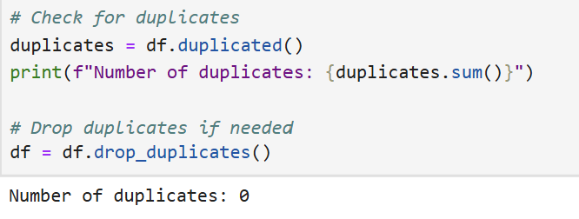
RESULTS
Number of duplicates in the dataset.
Demo Link

Slide 7
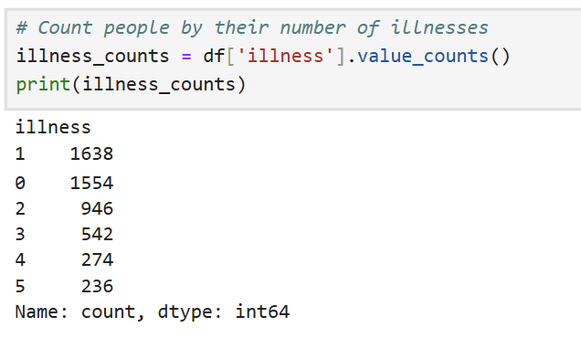
Total number of people based on count of illness.

Slide 8
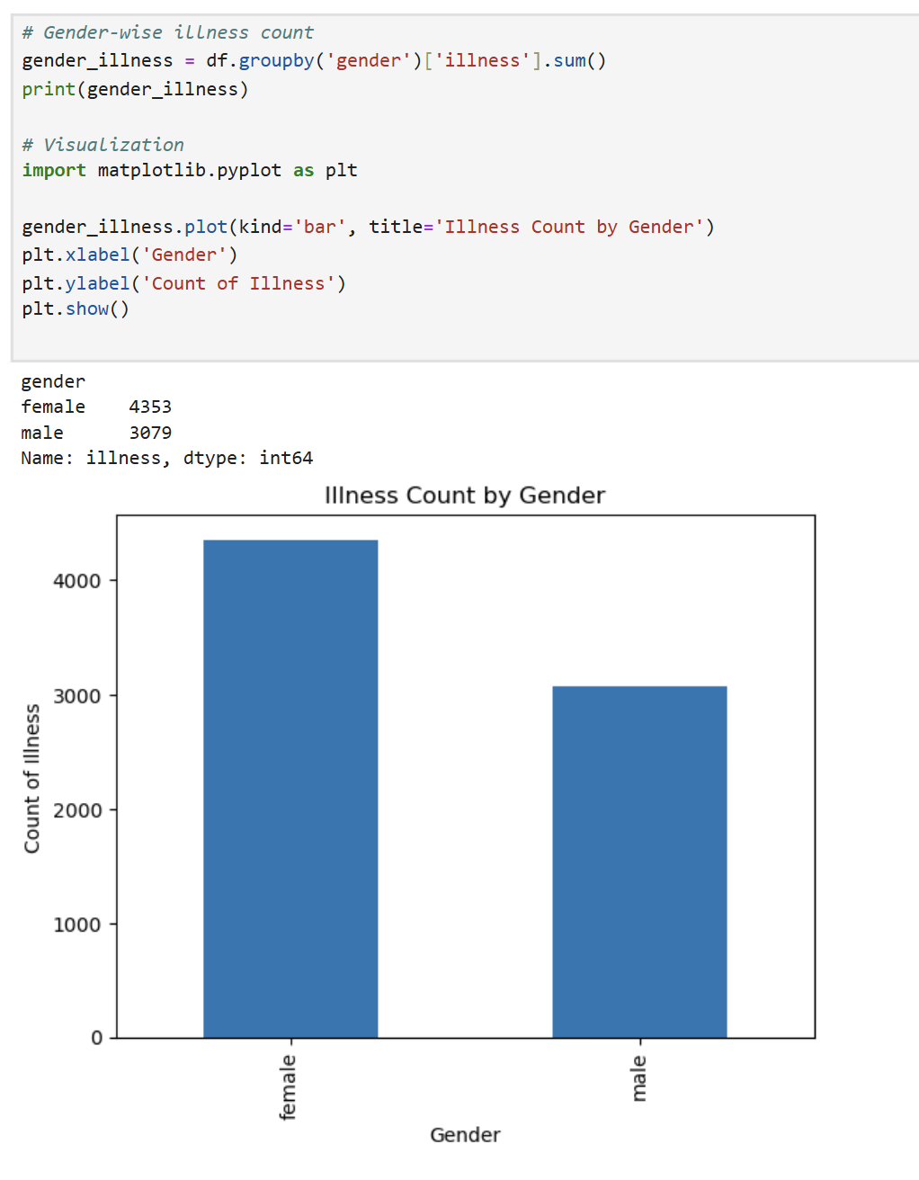
Gender-wise illness analysis.

Slide 9
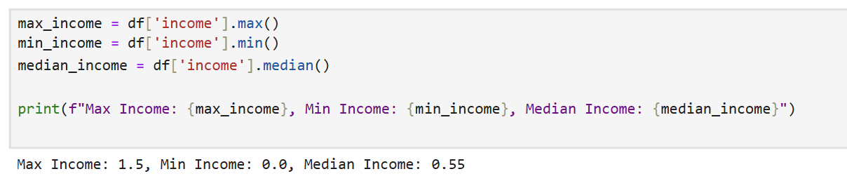
Maximum, minimum, and median income levels.

Slide 10
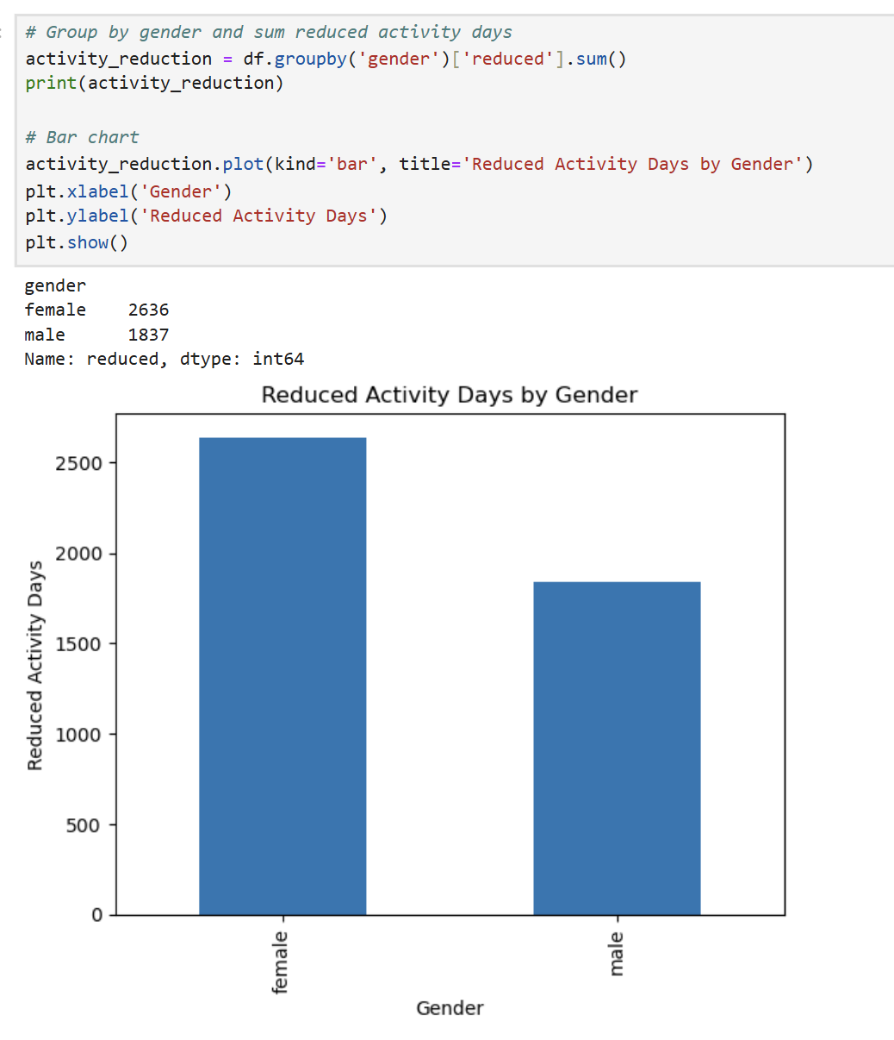
Reduced activity days of males and females due to illness.

Slide 11
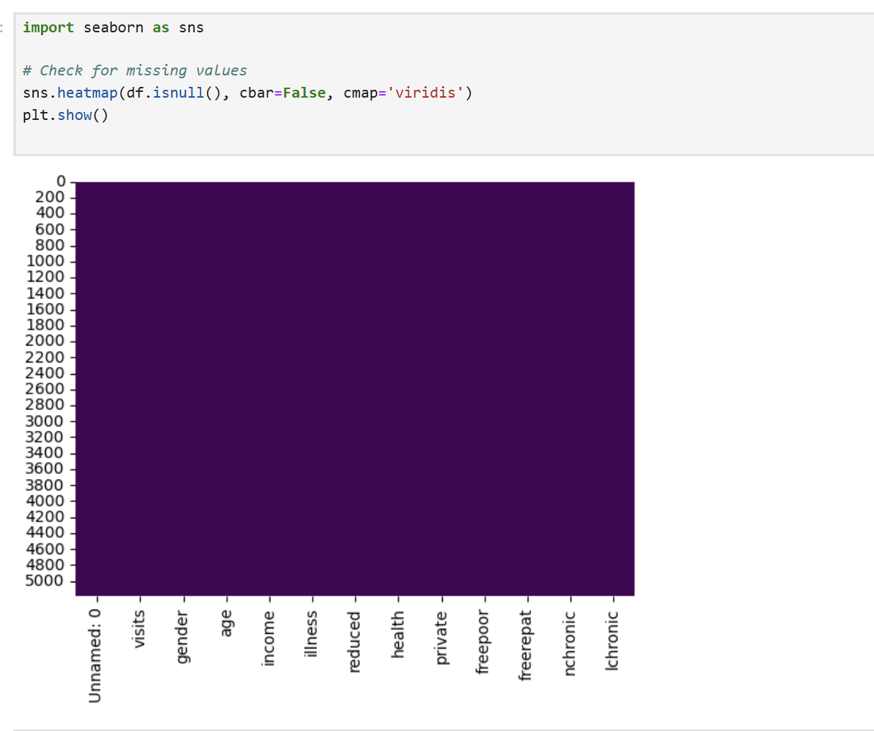
Missing values visualization using a heatmap

Slide 12
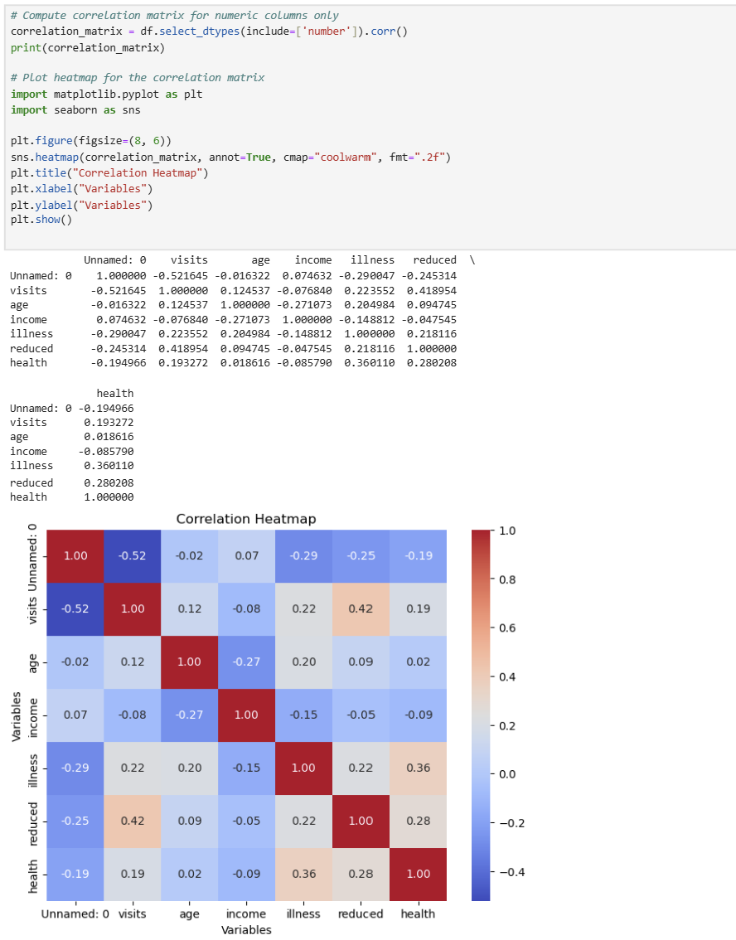
Correlation between dataset variables.

Slide 13
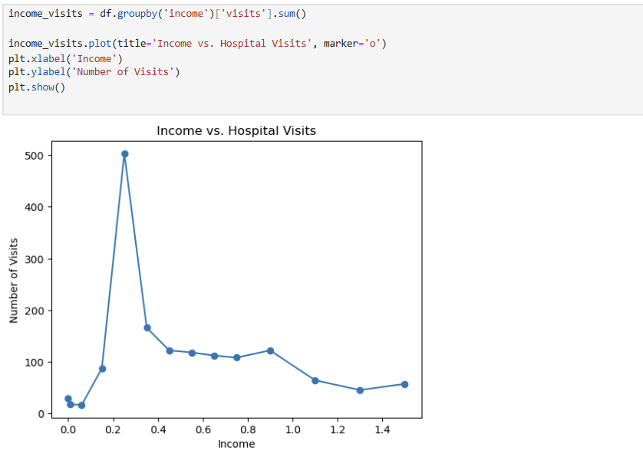
Income vs. number of hospital visits.

Slide 14
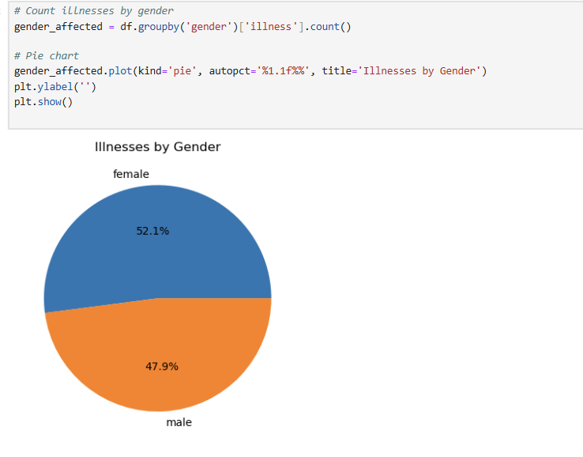
Count and visualization of males and females affected by illness.

Slide 15
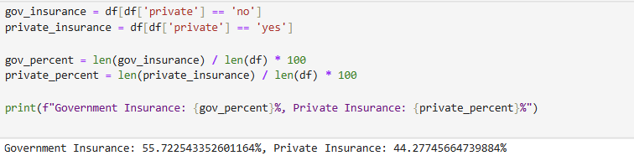
Percentage of people with government vs. private health insurance.

Slide 16
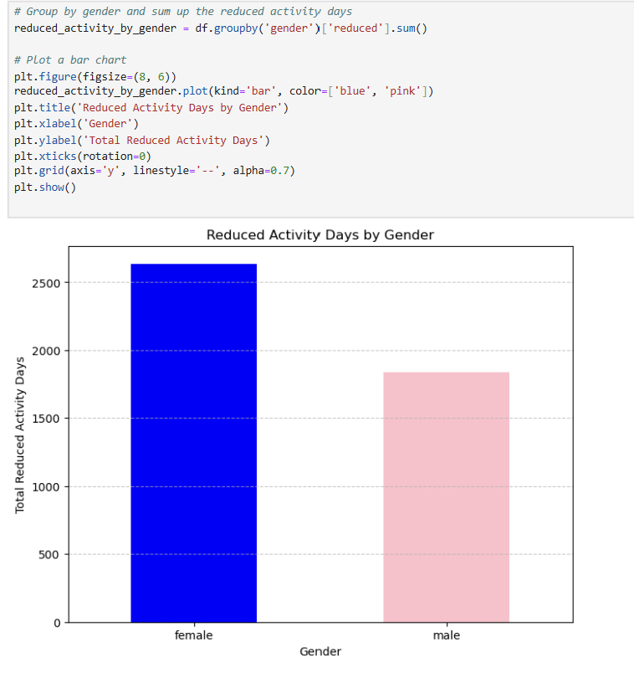
Bar chart: Reduced activity days by gender.

Slide 17
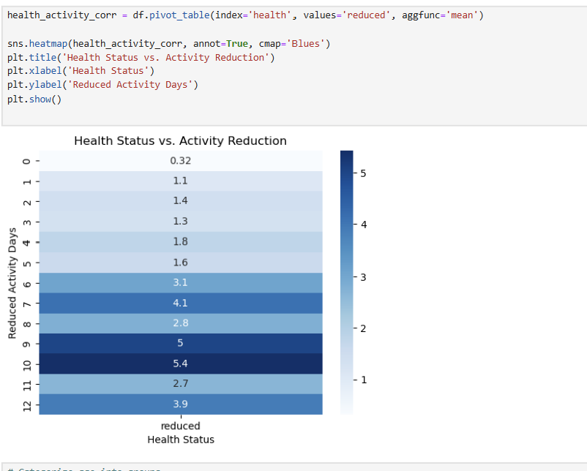
. Health status vs. activity reduction.

Slide 18
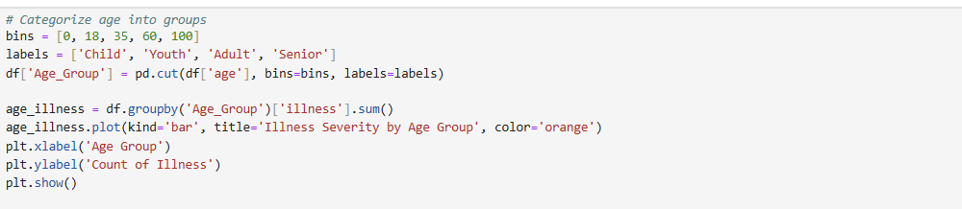
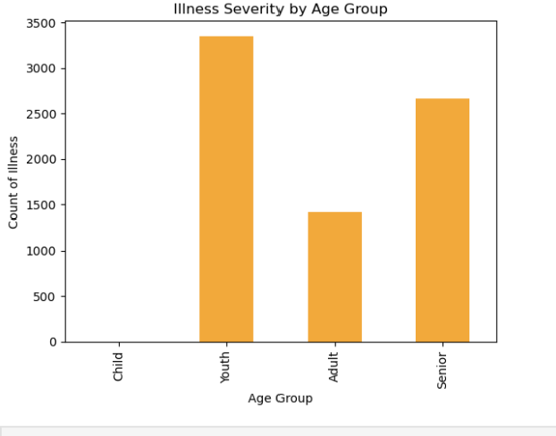
Additional analysis: Age group vs. illness severity.

Slide 20
Thank you
.
.

